Slide 1
University Event Monitoring And Tracker System
PROJECT TEAM
21IT1001-ABHINAV S
21IT1005-ATHUL K
21IT1008-BOPPANI VAMSHI

Slide 2
AGENDA
Abstract
Motivation behind Project
Literature Survey
Inference from Literature Survey
Proposed Project “University Event monitoring and tracking system ”.
High Level Architecture Diagram
Input screen shot
Process
Output screen shot
Modular Decomposed of UEMTS with cohesion and coupling
Event Management Module
End user registration with selection acknowledgement Module
Role based admin monitoring system Module
Test case Generation with Project Output/Result
Conclusion with Future Enhancement
References

Slide 3
ABSTRACT
Universities struggle with disorganization of events and it’s misleading financial problem.
Attendees face a long waiting registration processes and facing difficulties in conforming registeration with not enough confirmation for registration, impacting satisfaction and engagement.
Administrators find it difficult to monitor event progress and manage user roles effectively, leading to increased workload and inefficiencies.
Overcoming this issue, “University Event Monitoring & Tracker System” provides a comprehensive solution to enhance operations and user experience in the participation of the events.

Slide 4
MOTIVATION BEHIND THE PROJECT
The University Event Monitoring and Tracking System addresses challenges in university event management, including disorganization, inefficiency, and misleading financial issues. To tackle these challenges, our system offers a comprehensive solution with the following motivations:
To Enhance Event Management Efficiency:
Centralize the creation, scheduling, and administration of events, eliminating the need for disparate tools and manual processes.
Provide a unified platform that streamlines logistical details and ensures all stakeholders are informed and coordinated.
To Simplify Registration Processes:
Offer a user-friendly registration interface that allows students, faculty, and other participants to easily sign up for events.
Provide instant confirmation and timely updates to prevent miscommunication and ensure participants are well-informed.
To Improve Administrative Oversight:
Implement a role-based access control system that gives administrators the appropriate level of access and authority.
Provide real-time monitoring of event activities, analytics, and reporting tools to enhance transparency and decision-making.
Ensure accurate financial records.
To Enhance User Experience:
Ensure participants receive clear communication and registration confirmation, enhancing their overall experience.
Provide a streamlined, efficient, and organized event management system that meets the needs of all users.

Slide 5
LITERATURE SURVEY
S.NO | TITLE | JOURNAL DETAILS | TECHNICAL DESCRIPTION | RESEARCH GAP
1 | International Journal of Event Management Research | Andrews, J. (2019). Managing events in higher education. Int. J. Event Manag. Res., 8(1), 45-58. | This article highlights the inefficiencies in coordinating volunteers and managing their registration process. It underscores challenges in coordination and resource allocation, impacting volunteer management within academic institutions. | In this Study, Volunteer approval system needs easy registration process and conformation of acceptance.
2 | Journal of Impact of Confirmation Methods on Attendance | Chen, L., et al. (2018). Digital solutions for event planning: A literature review., Confirmation Methods on Attendance 45(3), 211-225. | This study investigates how email, SMS, and phone call confirmations affect event attendance and satisfaction. Results show that proactive confirmation notably boosts attendance rates and participant satisfaction, emphasizing the critical role of effective communication in event management. | Existing literature needs improvement with more Confirmation Methods in a way to improve registeration conformation.
3 | Journal of Event Management | Edwards, J., & Smith, A. (2021). Functionalities and capabilities of event management systems. J. Event Manage., 11(2), 132-145. | This study analyzes the essential features of event management systems that streamline planning, enhance coordination, and improve event execution. It offers practical insights for event organizers and managers on optimizing event organization. | The existing Event Management System lack efficiency in managing events and needs improvement in role base management.

Slide 6
INFERENCE FROM LITERATURE SURVEY
Improving the admin role management system is crucial, highlighted by inefficiencies in coordinating volunteers and managing their registration process. Simplified volunteer registration and efficient confirmation of acceptance are essential for enhancing overall volunteer management effectiveness.
Improving Confirmation Methods for registered event verification is crucial. This study explores how email, SMS, and phone call confirmations boost attendance and satisfaction, emphasizing effective communication. Integrating event document generation optimizes organization.
Event Management System lacks efficiency in managing events and requires improvement in role-based management. Enhancing planning, coordination, and event execution are critical for optimizing event organization
Based on the inferences from literature survey, overcoming the issues this project entitled “University Event Monitoring and tracker system” is proposed.

Slide 7
PROPOSED UEMTS OBJECTIVES
The objective of this project is to develop a University Event Monitoring and Tracker System using comprehensive skills and techniques from the field, ensuring the avoidance of common development mistakes. The primary objectives of this project are to address the fundamental limitations of traditional university event management systems, including:
Disorganized Event Management.
Cumbersome Registration Processes.
Poor Administrative Oversight.
Inefficient Communication.
Manual Coordination and Tracking.
Limited Reporting and Analytics.

Slide 8
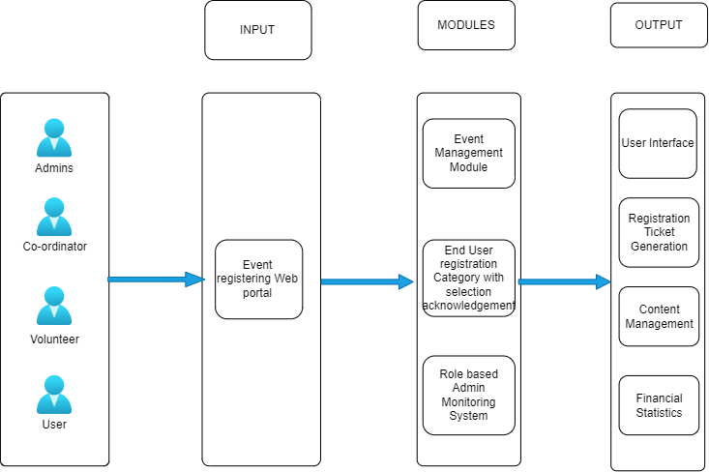
UEMTS HIGH LEVEL ARCHITECTURE
Fig: 1.1 – UEMTS high level Architecture

Slide 9
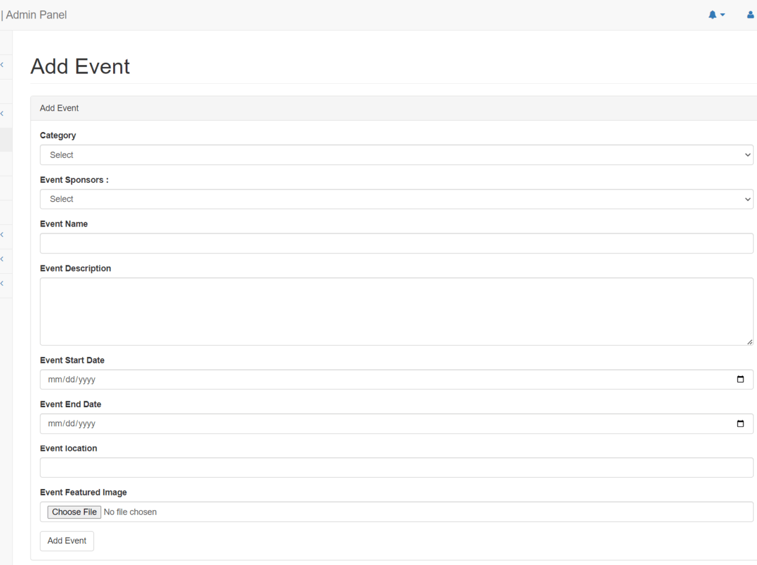
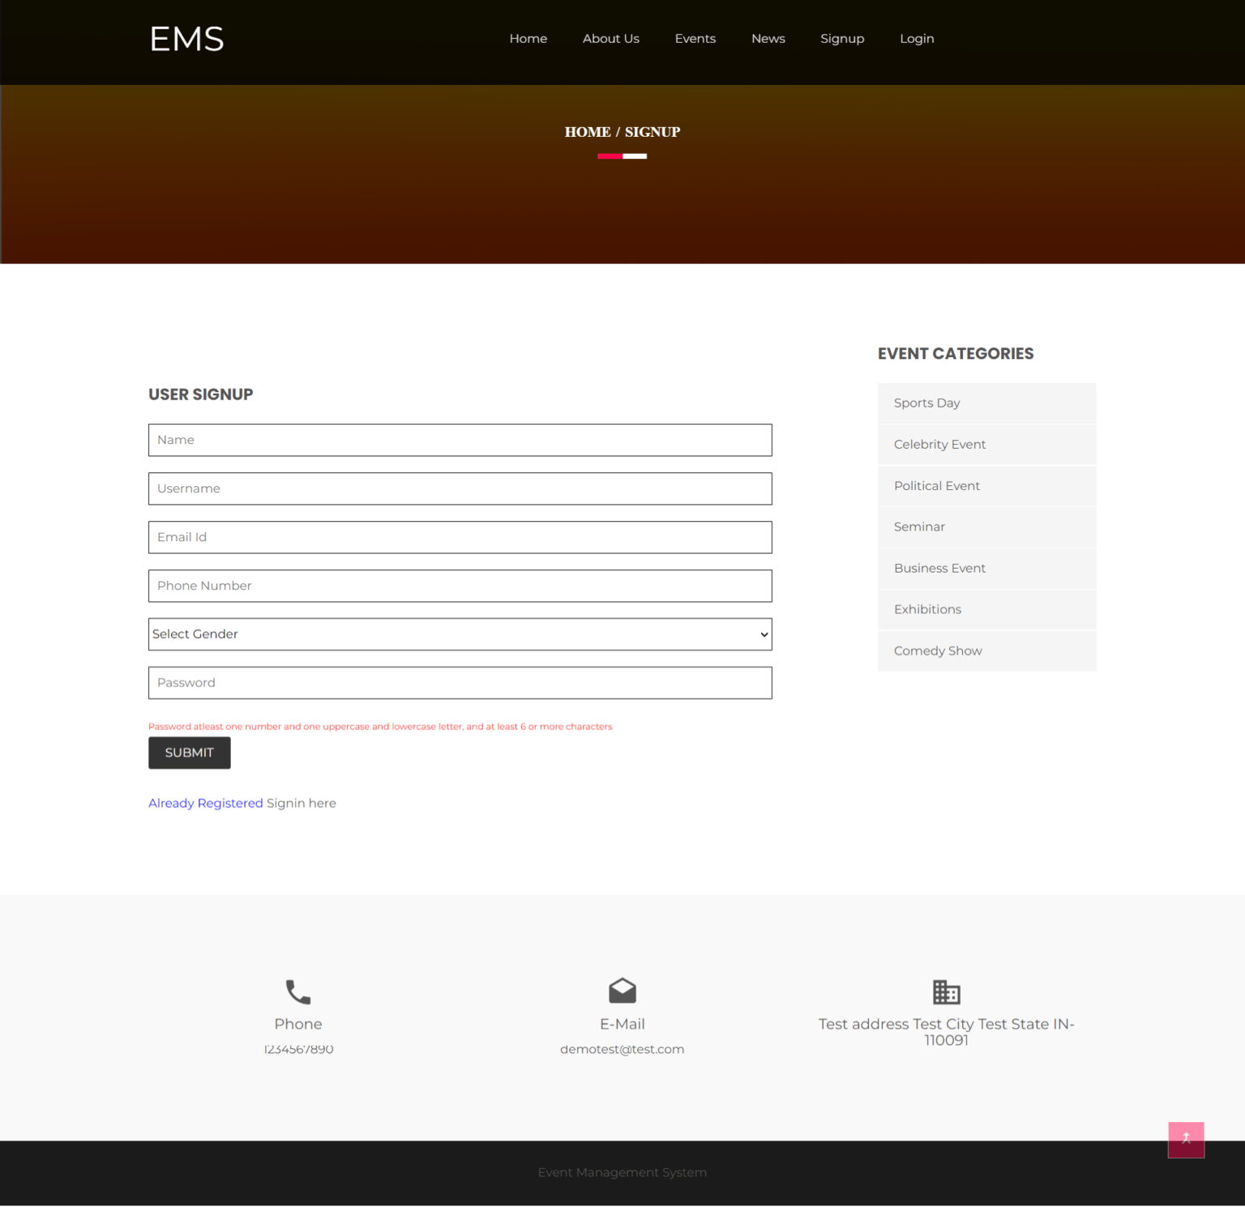
INPUT
Fig: 1.2 – Add Event
Fig: 1.3 – User Signup Form

Slide 10
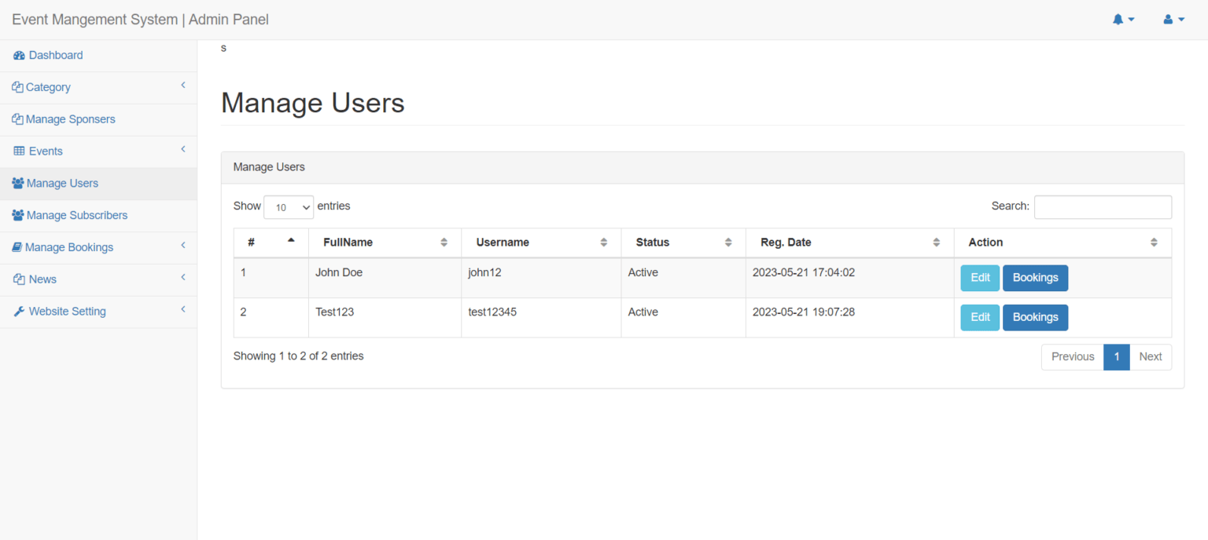
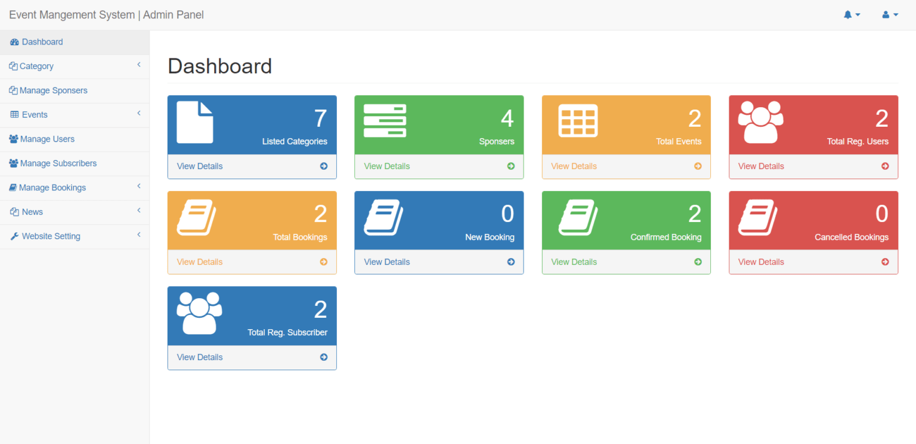
EXPECTED OUTPUT SCREEN SHOT
Fig: 1.4 – Manage Registration
Fig: 1.5 – Admin Dashboard

Slide 11
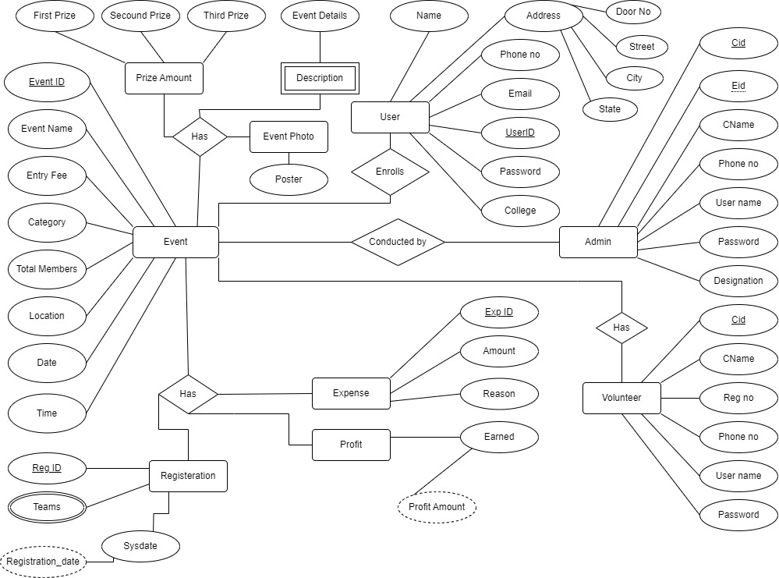

UEMTS ENTITY RELATIONSHIP DIAGRAM
Fig: 1.6 – UEMTS ER Diagram

Slide 12
MODULAR DECOMPOSED OF UEMTS
Event Management Module
End user registration with selection acknowledgement Module
Role based admin monitoring system Module

Slide 13
Event management Module
Comprehensive Technological Solution: Introduces a centralized digital platform to modernize planning and administration of university events.
Event Creation and Scheduling: Allows event organizers to efficiently create, schedule, and manage events.
Key Features:
Detailed Event Calendar: Provides a comprehensive overview of scheduled events.
Task Assignment Capabilities: Enables organizers to assign tasks to team members.
Resource Management Tools: Facilitates effective management of event resources.
Data Centralization: Ensures all event information is stored in one accessible place, reducing the risk of miscommunication and oversight.

Slide 14
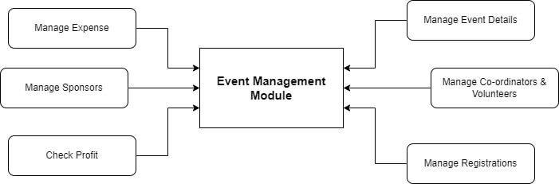
EVENT MANAGEMENT MODULE
Fig: 1.7 – Event Management Module Diagram

Slide 15
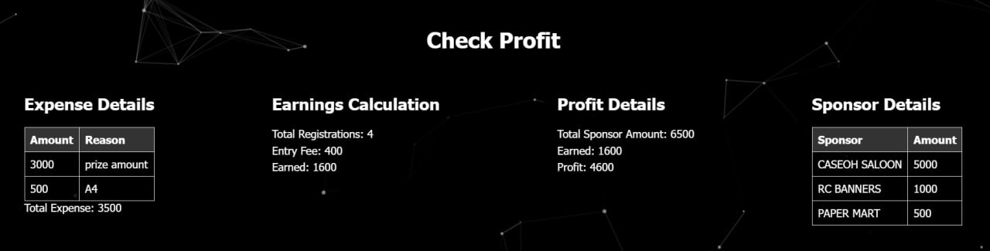
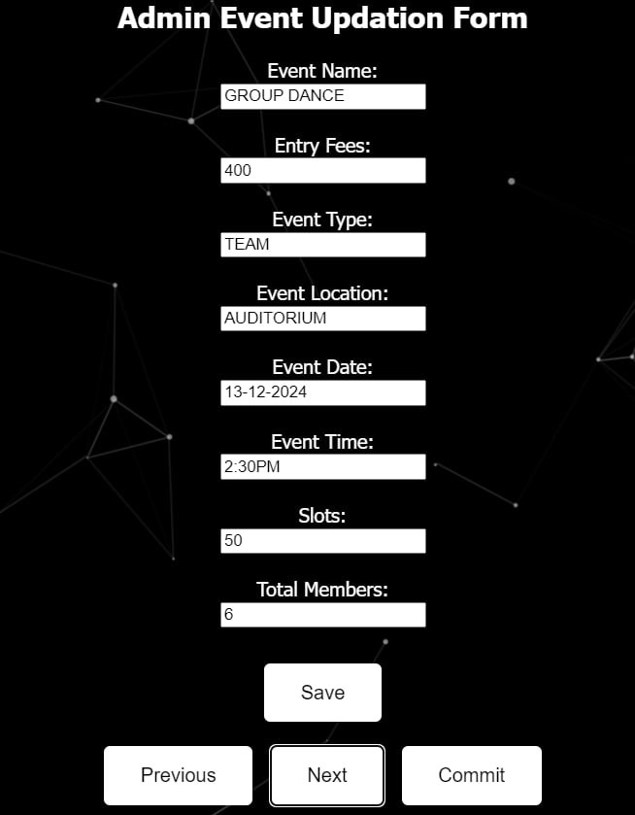
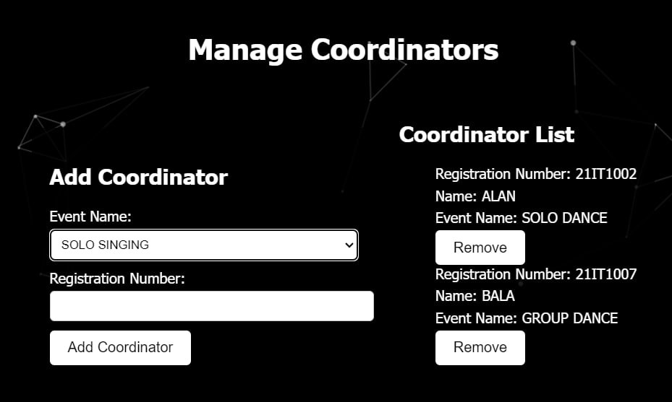
OUTPUT:
Fig 1.9 – Coordinator’s Event profit
Fig 1.8 – Add Event form
Fig 1.10 – Manage Coordinators

Slide 16
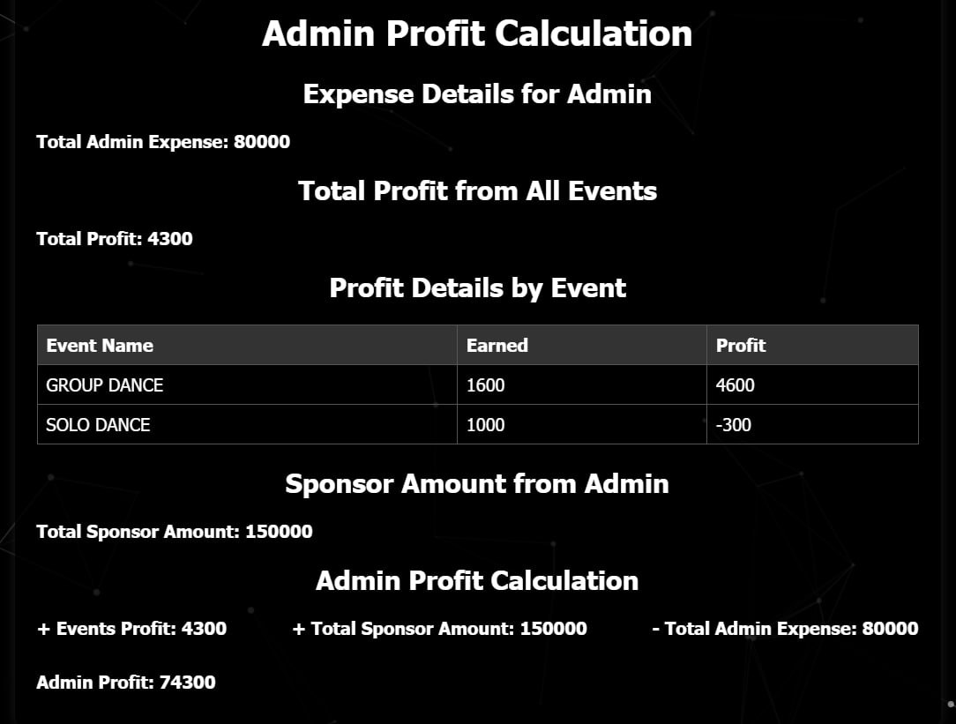
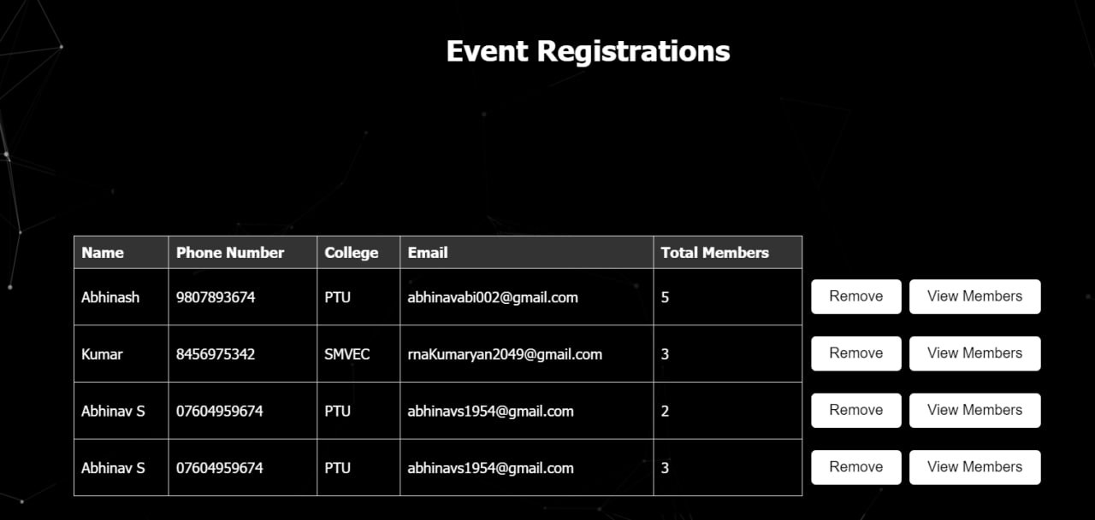
Fig 1.11 – Admin Profit
Fig 1.12 – View Registerations

Slide 17
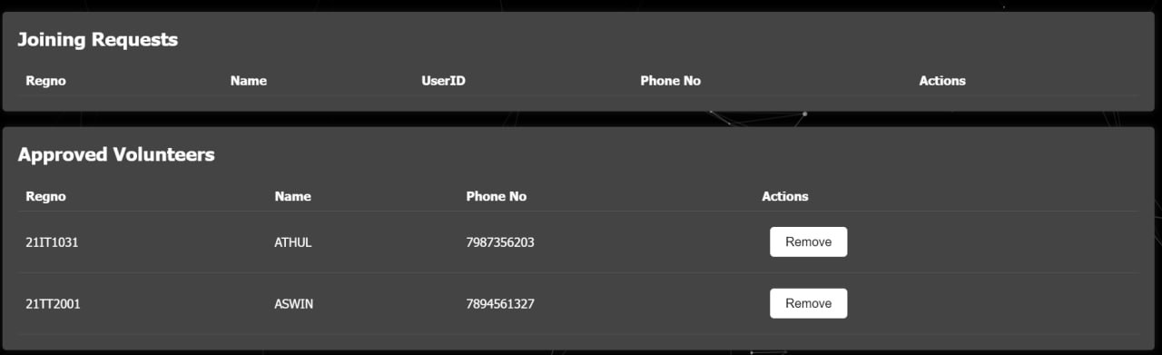
Fig 1.13 – Volunteer Approval

Slide 18
End user registration with selection acknowledgement Module
Facilitate seamless registration for university events while providing users with a clear acknowledgment of their selections.
Design an intuitive form for users to enter personal details and select events they wish to attend.
Utilize a PDF generation library to create detailed registration confirmations including event details, user information, and acknowledgment.
Develop a user-friendly dashboard or "My Registration" page where users can review and download their event registrations.
Securely store generated PDFs associated with each user registration for easy retrieval and viewing.

Slide 19
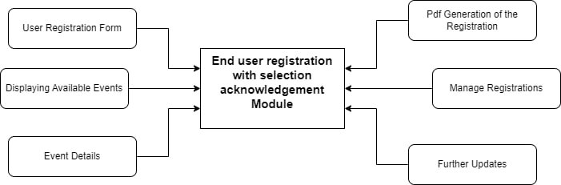
End user registration with selection acknowledgement Module
Fig: 1.8 – End User Registeration Module Diagram

Slide 20
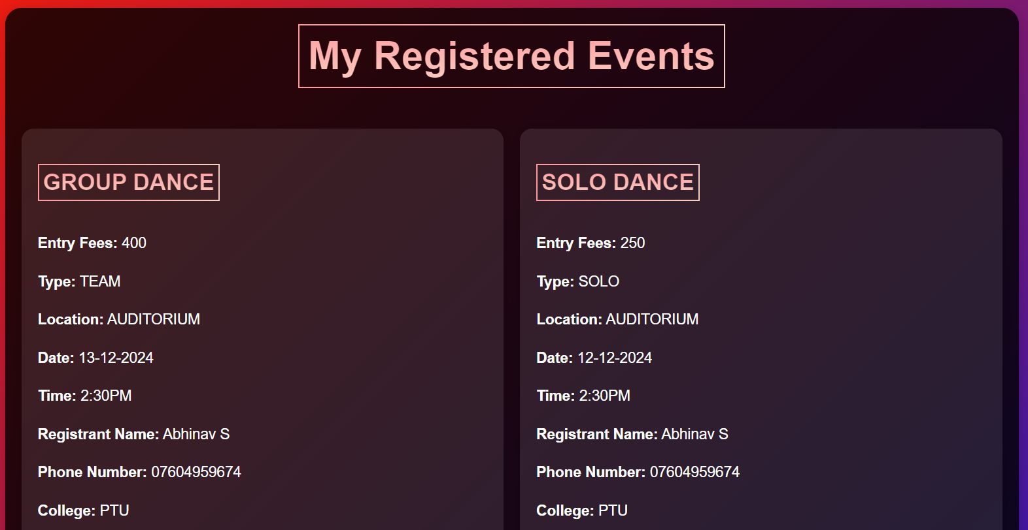
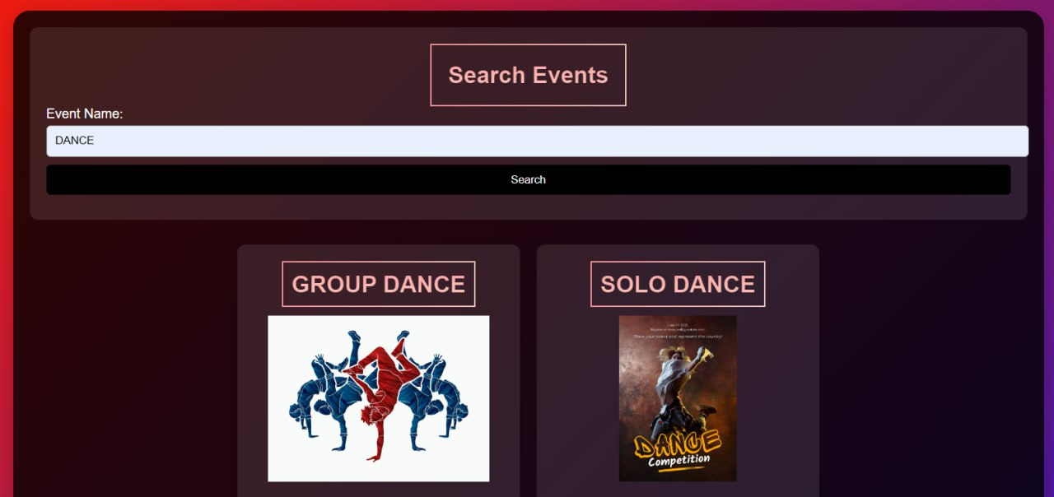
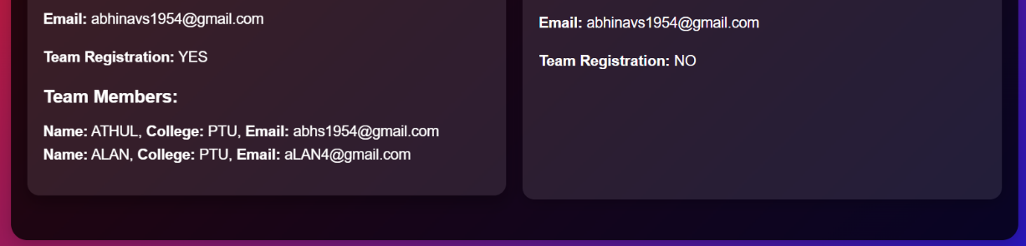
Fig 1.14 – Search Event
Fig 1.15 – Registered events in My Registerations

Slide 21
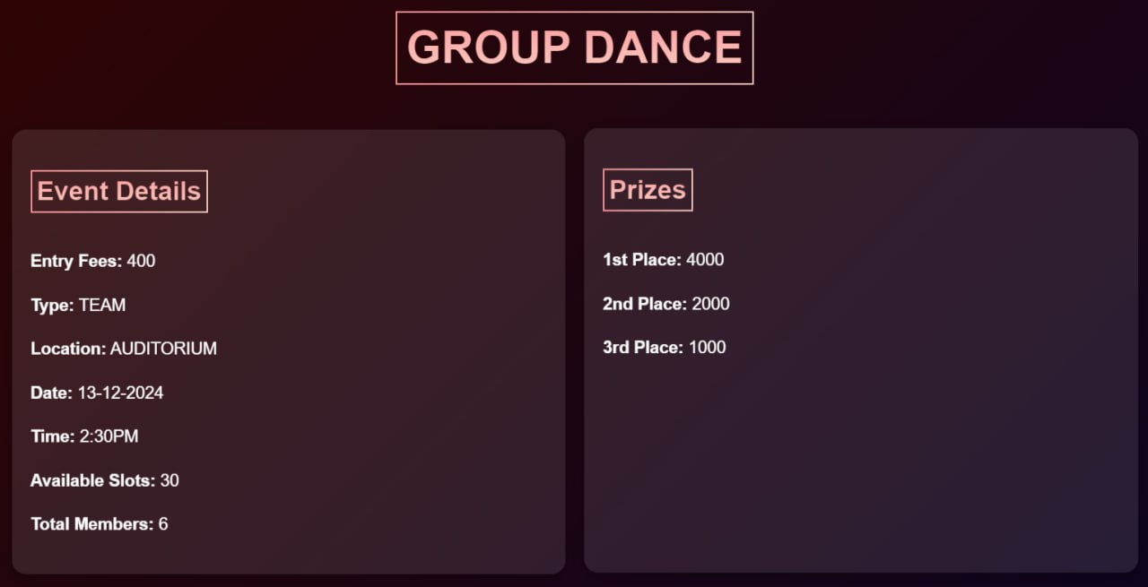
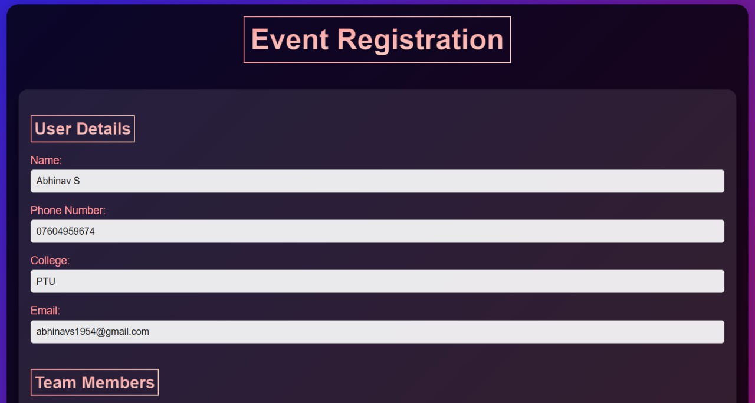
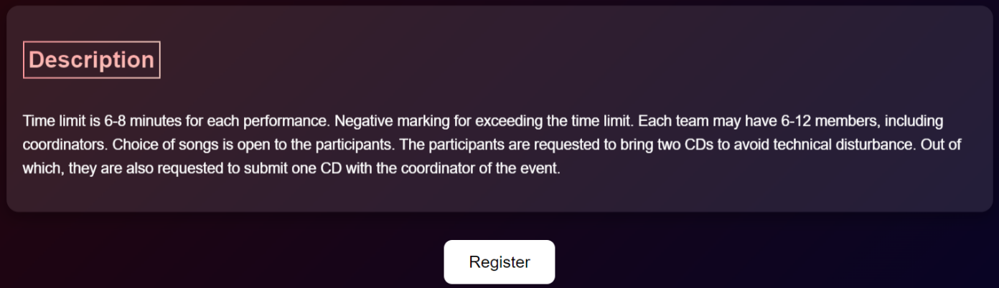
Fig 1.17 – Registeration form
Fig 1.16 – Displayed Event details to registered

Slide 22
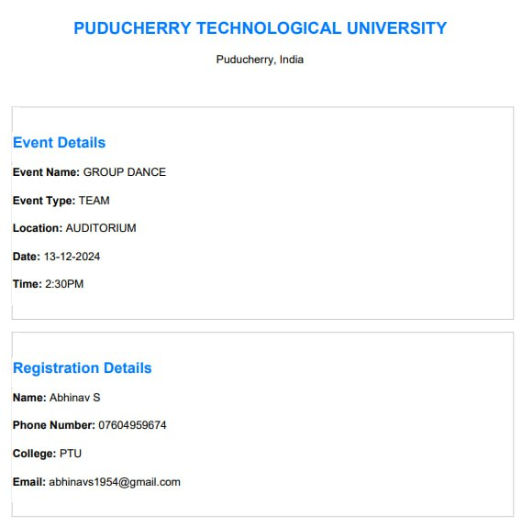
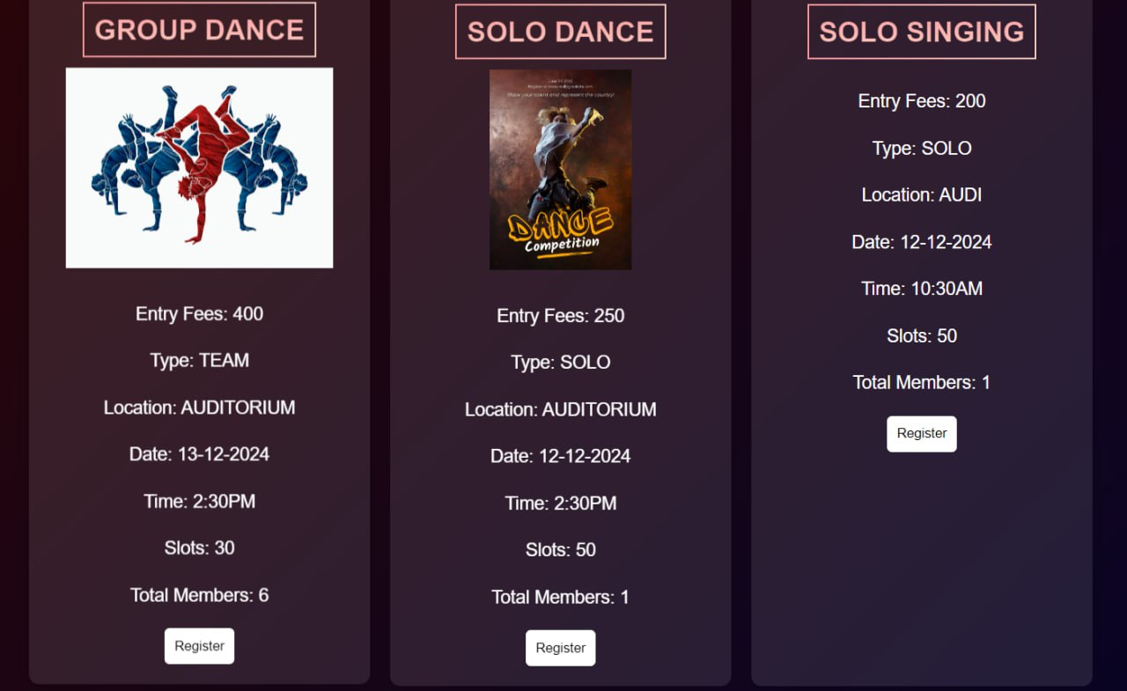
Fig 1.18 – Generated pdf
Fig 1.19 – All Events available to register

Slide 23
Role based admin monitoring system Module
Designate one main admin with full access and control over the entire system.
Admin can view and manage all events, coordinators, volunteers, and related data.
Assign one coordinator per event who has restricted views and permissions.
Coordinators can view and manage details specific to their assigned event only.
Assign multiple volunteers under each coordinator, each with restricted views and permissions.
Volunteers can access and update details related to their assigned event tasks only.
Develop a dashboard for admins to oversee all events and manage coordinator assignments.
Coordinators have a dedicated view to manage event-specific details and volunteer assignments.
Volunteers access a simplified view focused on their assigned tasks and responsibilities.

Slide 24
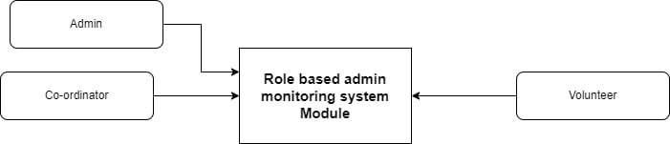
Role based admin monitoring system Module
Fig 1.20 – Admin Module Diagram

Slide 25
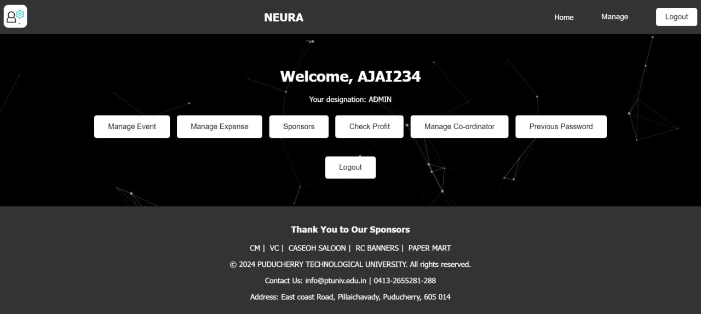
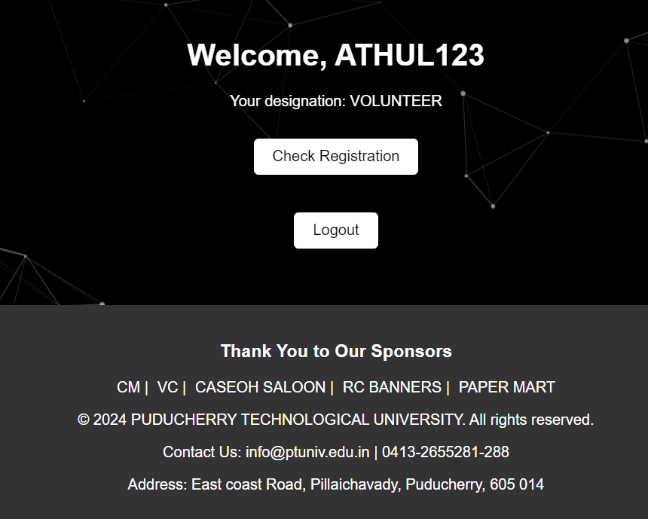
Different Roles:
Fig 1.21 – Admin Panel
Fig 1.22 – Volunteer Panel

Slide 26
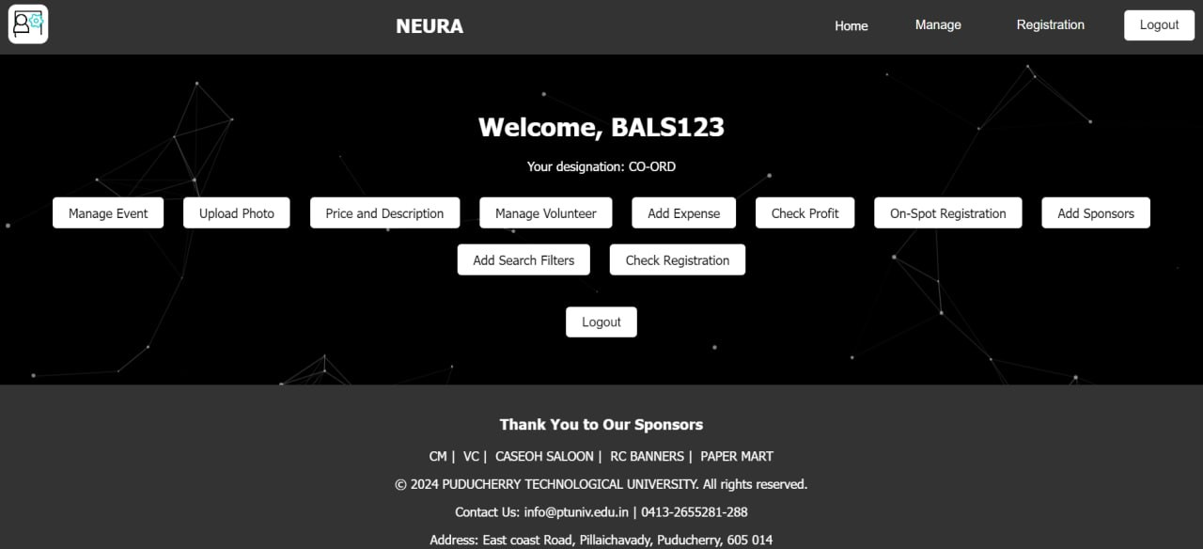
Fig 1.23 – Co-ord Panel
Fig 1.24 – Volunteer Joining Request Approval

Slide 27
Conclusion
Application of Project in Real Time :
Efficient Event Coordination: Enables real-time updates on event schedules and participant registrations, minimizing scheduling conflicts and enhancing coordination among organizers and departments.
Enhanced User Experience: Provides a seamless user interface for event registration and management, ensuring quick access to event details, payment processing, and PDF generation of registered events for participants.
Streamlined Administrative Oversight: Facilitates role-based access for administrators, coordinators, and volunteers, allowing them to efficiently manage event-specific details, financial information, and participant engagement in real time.

Slide 28
Conclusion - condt.
Future Enhancement :
Integration of Cryptocurrency Wallet and Transactions:
Integrate cryptocurrency wallet functionality for event transactions.
Enable participants to make payments and donations using cryptocurrencies, enhancing flexibility and accessibility.
Enhanced Audience Engagement Tools:
Implement advanced audience engagement features such as augmented reality (AR) experiences.
Allow participants to interact with event content in innovative ways, fostering deeper engagement and participation.
Implementation of AI-Powered Chatbots:
Provide real-time assistance to attendees and organizers.
Streamline the event registration process through automated responses and guidance.
Integration of Virtual Reality (VR) Technology:
Offer immersive virtual tours of event venues.
Allow attendees to explore and familiarize themselves with event setups beforehand, enhancing their experience and preparation.

Slide 29
REFERENCES
1.Abraham Silberschatz, Henry F. Korth, and S. Sudarshan. (2010). Database System Concepts.
2.Andrews, R. (2019). "Event Management in Higher Education: Challenges and Opportunities." Journal of Higher Education Administration, 35(2), 87-102.
3.Basso, J., et al. (2018). "Improving Event Management Processes Through Technology: A Case Study." Journal of Event Management, 10(2), 87-102.
4.Barker, K., & O'Brien, S. (2020). "Enhancing Event Coordination Through Technology: A Case Study." International Journal of Event Management Research, 8(1), 45-58.
5.Chen, L., et al. (2018). "Digital Solutions for Event Planning: A Review of Literature." Journal of Information Technology and Event Management, 12(2), 102-115.
6.Davidson, M., et al. (2017). "Improving Efficiency in University Events Through Technology Integration." Journal of Educational Technology Research, 45(3), 211-225.
7.Edwards, H., & Smith, J. (2021). "Event Management Systems: A Comprehensive Review." Journal of Event Technology, 14(1), 30-45.
8.Fletcher, A., & Brown, M. (2019). "Streamlining Event Registration Processes: Best Practices and Challenges." Journal of Event Management, 11(2), 132-145.
9.Garcia, S., et al. (2020). "Role-Based Admin Monitoring Systems: Design and Implementation Strategies." International Journal of Human-Computer Interaction, 34(4), 276-289.
10.Hall, R., & Johnson, E. (2018). "User Experience Design Principles for Event Management Systems." Journal of User-Centered Design, 22(3), 150-165.

Slide 30
11.Ibrahim, N., et al. (2020). "Integrating Event Management Systems with University Portals: A Case Study." Journal of Educational Technology Integration, 38(1), 45-58.
12.Jackson, K., & White, L. (2019). "Enhancing Collaboration in University Events: Insights from Case Studies." Journal of Collaboration Research, 21(2), 89-104.
13.Kim, Y., & Park, S. (2017). "Event Management Trends and Innovations: A Comprehensive Overview." Journal of Event Technology, 10(1), 25-40.
14.Kim, Y., & Park, S. (2020). "Emerging Trends in Event Management Technology: A Review." Journal of Information Technology and Event Management, 12(1), 45-58.
15.Lee, H., & Lee, S. (2018). "Artificial Intelligence in Event Planning: Applications and Implications." Journal of Artificial Intelligence Research, 35(2), 120-135.
16.Martinez, A., et al. (2021). "Event Management Systems and Student Information Integration: A Case Study." Journal of Information Systems Integration, 39(3), 210-225.
17.Nguyen, T., & Smith, P. (2019). "User-Centered Design Principles for Event Management Systems: A Comparative Study." Journal of Usability Engineering, 28(4), 180-195.
18.MySQL :: The World's Most Popular Open Source Database. [Online]. Available: https://www.mysql.com/.
19.PHP: Hypertext Preprocessor. [Online]. Available: https://www.php.net/.
20.www.geekforgeeks.com.
21.www.w3schools.com.

Slide 31
THANK YOU!

